Slide 1
Lecture 6: Fundamentals Part 5 Hydrology
WMD651: Water Resources Systems Design
2021 January 22
School of Environmental And Civil Engineering Technology, Seneca College
Johnathan D. Nault

Slide 2
Hydrology and Hydraulics
Deterministic v. stochastic processes:
Deterministic: outcomes known with high certainty
Stochastic: outcomes characterized by randomness
Hydraulics is based on physical laws with predictable outcomes → deterministic
Hydrology:
Deterministic: overland flow, infiltration
Stochastic: rainfall, temperature, climate → unpredictable, complex, large range
For analysis, some parameters are prescribed based on inferences from statistics, and mechanics determine the physical response

Slide 3
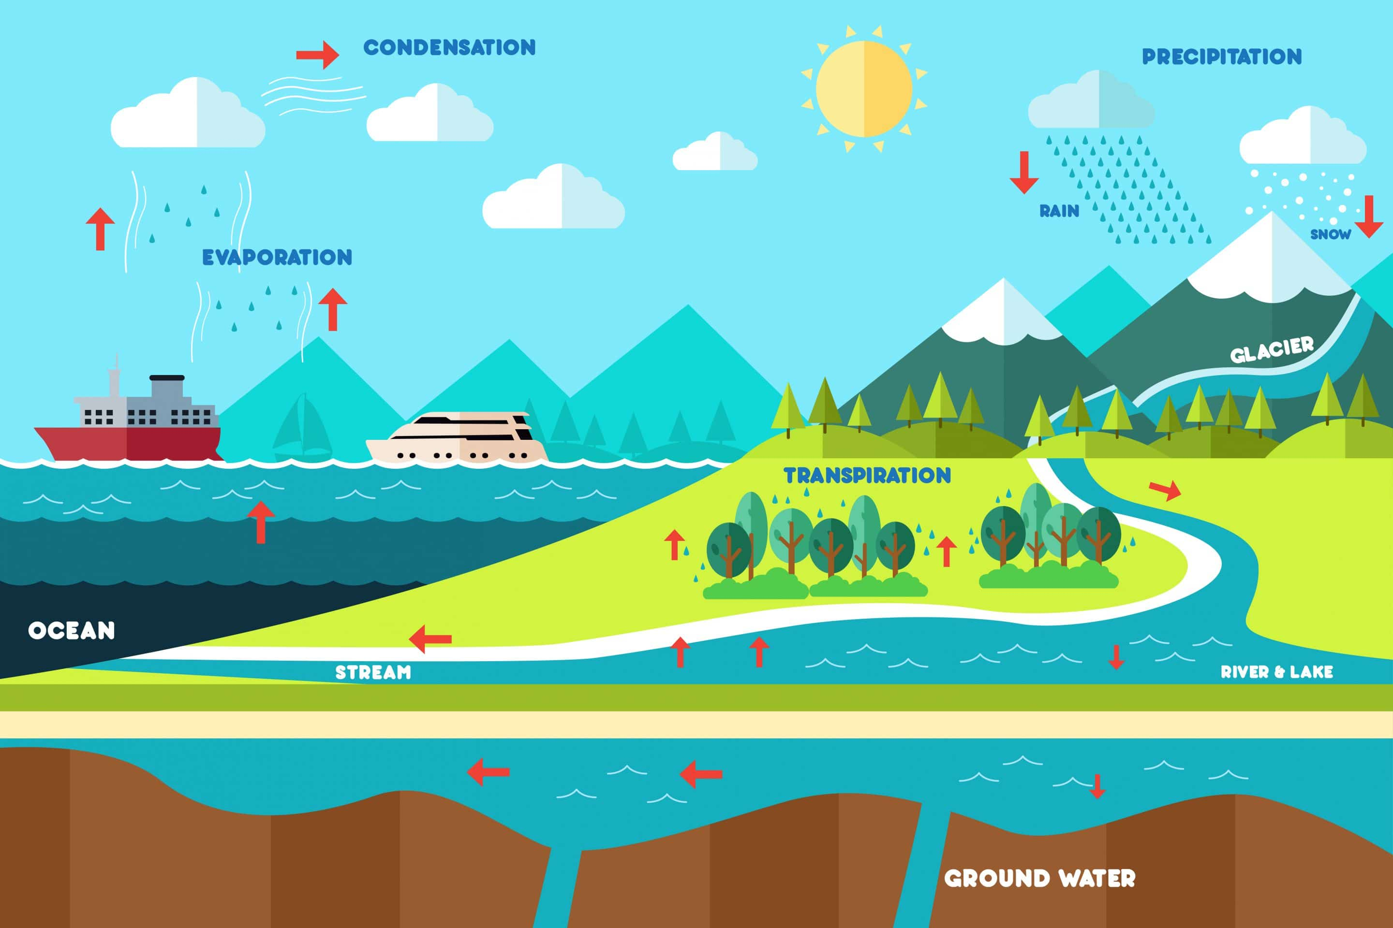
Macro Level – Water Cycle
Conservation Institute (2018)

Slide 4
Urban Hydrology
Urban hydrology concerns hydrologic processes in urban (built) environments
Also interacts with hydrology of natural environments – e.g., buried rivers in cities
Typical characteristics:
More impervious surfaces (roads, buildings) and fewer natural channels
Faster response to storms, less attenuation → lower time of concentration
Lower infiltration → greater runoff

Slide 5
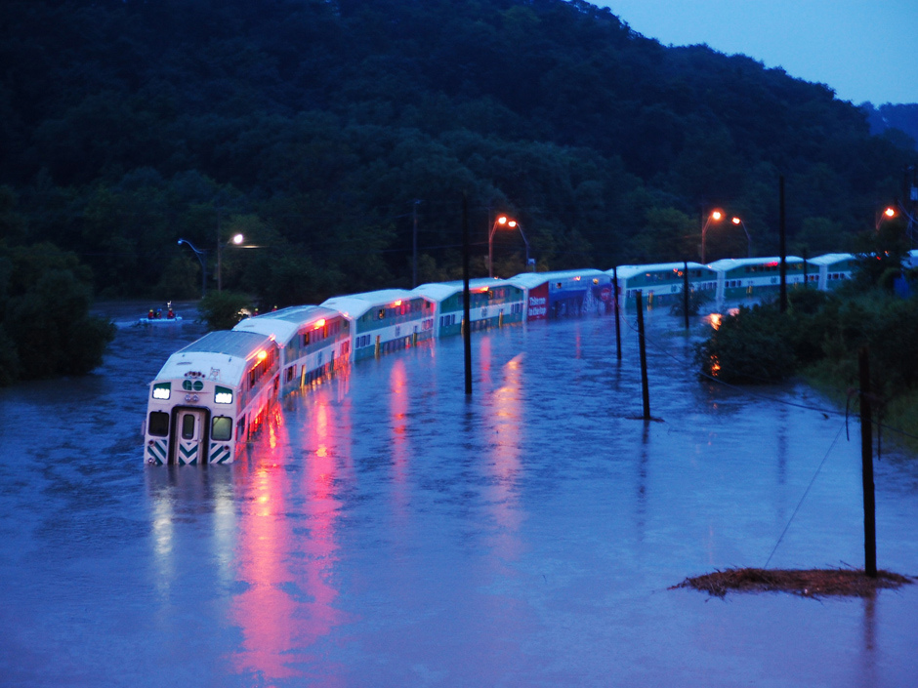
Urban Hydrology
GO Train stranded in the Don River on 2013 July 10 (The Toronto Star, 2013)

Slide 6
Local Level Hydrology
Consider a mass balance for a hydrologic system:
Multiple inflows and outflows, all interrelated

Slide 7
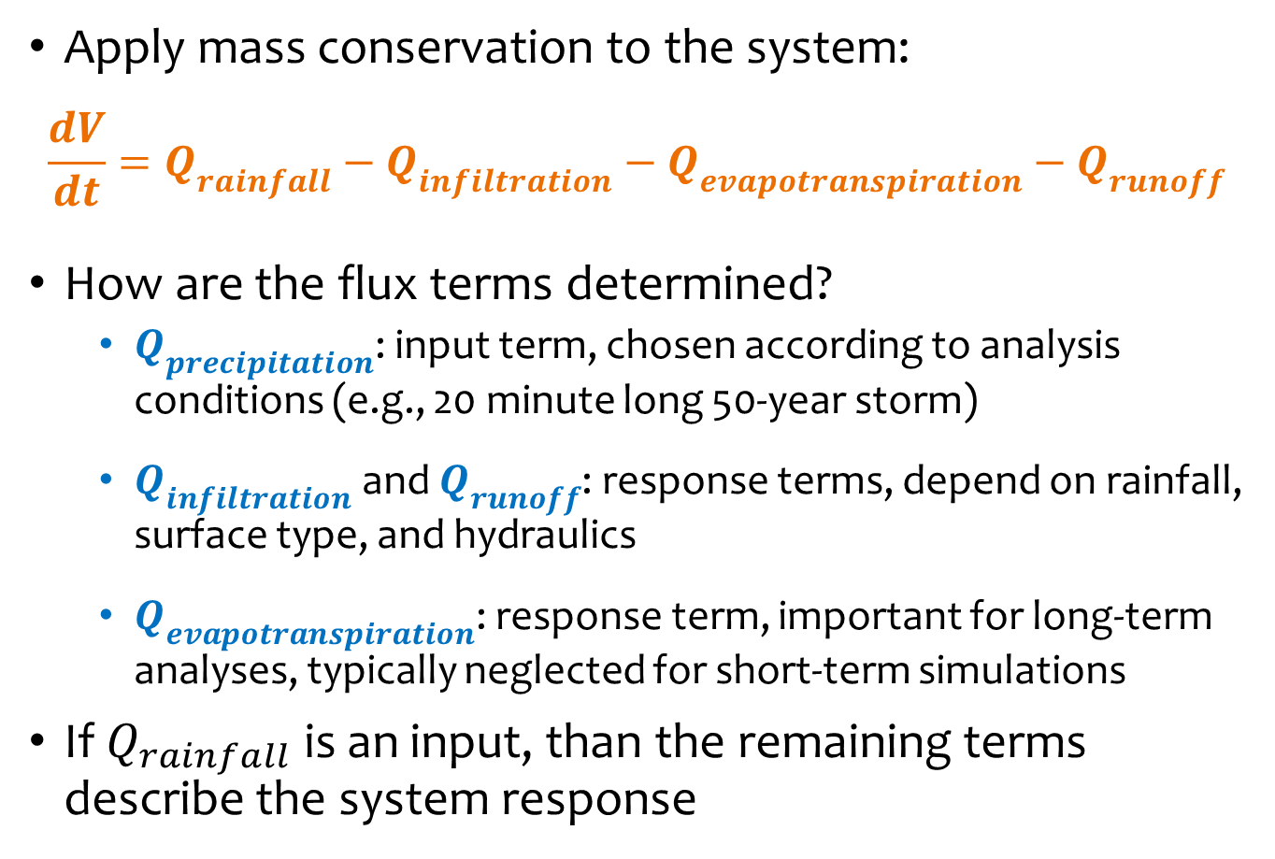
Representing Hydrologic Processes
Apply mass conservation to the system:
$$\frac{dV}{dt}=Q_{rainfall}−Q_{infiltration}−Q_{evapotranspiration}−Q_{runoff}$$
How are the flux terms determined?
$Q_{precipitation}$: input term, chosen according to analysis conditions (e.g., 20 minute long 50-year storm)
$Q_{infiltration}$ and $Q_{runoff}$: response terms, depend on rainfall, surface type, and hydraulics
$Q_{evapotranspiration}$: response term, important for long-term analyses, typically neglected for short-term simulations
If $Q_{rainfall}$ is an input, than the remaining terms describe the system response

Slide 8
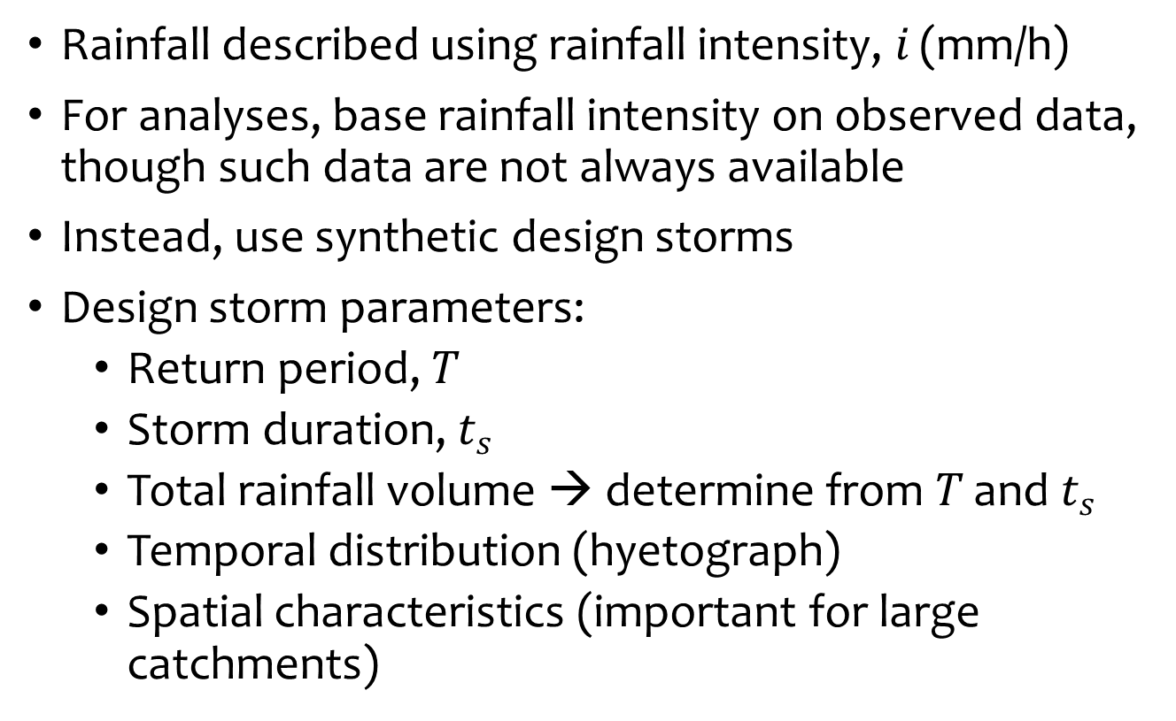
Rainfall
Rainfall described using rainfall intensity, $i$ (mm/h)
For analyses, base rainfall intensity on observed data, though such data are not always available
Instead, use synthetic design storms
Design storm parameters:
Return period, $T$
Storm duration, $t_{s}$
Total rainfall volume → determine from $T$ and $t_{s}$
Temporal distribution (hyetograph)
Spatial characteristics (important for large catchments)

Slide 9
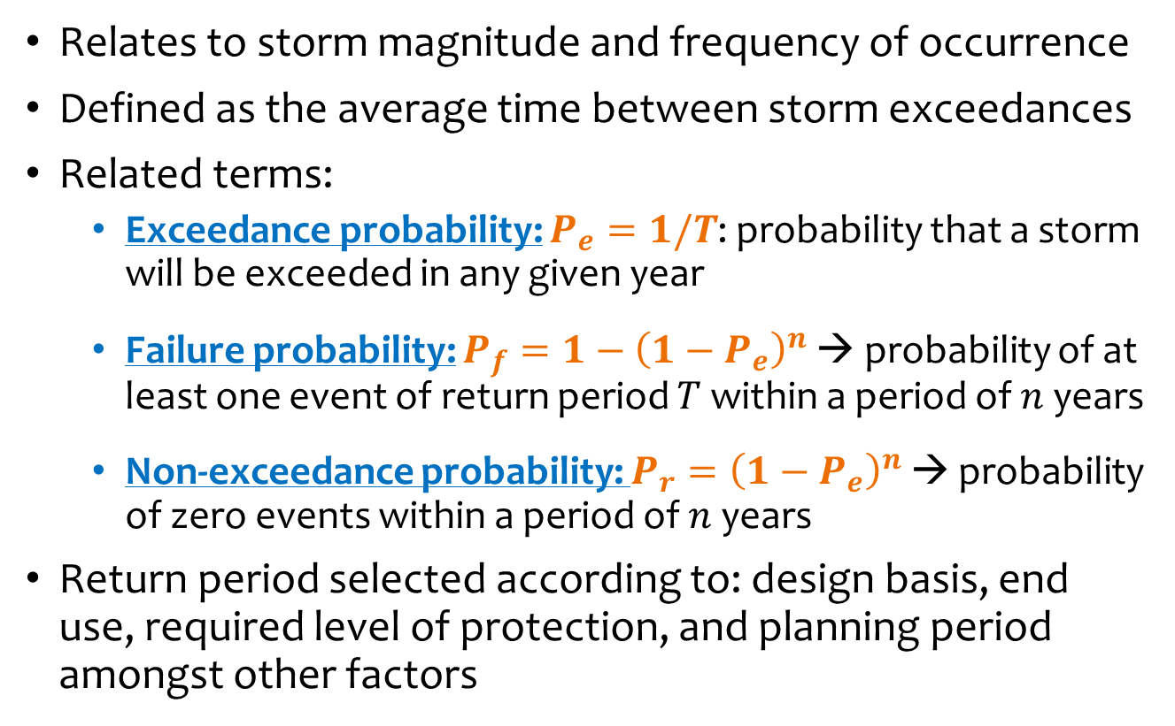
Return Period
Relates to storm magnitude and frequency of occurrence
Defined as the average time between storm exceedances
Related terms:
Exceedance probability: $P_{e}=1/T$: probability that a storm will be exceeded in any given year
Failure probability: $P_{f}=1−{\left(1−P_{e}\right)}^{n}$ → probability of at least one event of return period $T$ within a period of $n$ years
Non-exceedance probability: $P_{r}={\left(1−P_{e}\right)}^{n}$ → probability of zero events within a period of $n$ years
Return period selected according to: design basis, end use, required level of protection, and planning period amongst other factors

Slide 10
A Few Misconceptions
A 50-year event will not always occur (or be exceeded) within a 50 year period
A 25-year event and a 50-year event can occur within the same year
Compare like to like: a 25-year storm does not necessarily correspond to the 25-year peak runoff
→ Return period is defined on an annual basis – it relates to the largest storm in a given year

Slide 11
Rainfall Hyetographs
Various methods for synthetic hyetographs to define rainfall temporal profiles
Soil Conservation Service (SCS) distributions (now Natural Resources Conservation Service)
Type I and Type Ia: pacific maritime climates (dry summers, wet winters)
Type II: continental provinces and states (characterized by high intensity thunderstorms)
Type III: Atlantic coastline (tropical storms rainfall)
AES distribution: based on rain gauges throughout Canada, use regional average data
Chicago distribution: synthetic hyetograph based on collection of peak intensities

Slide 12
Hyetographs – SCS Distributions

Slide 13
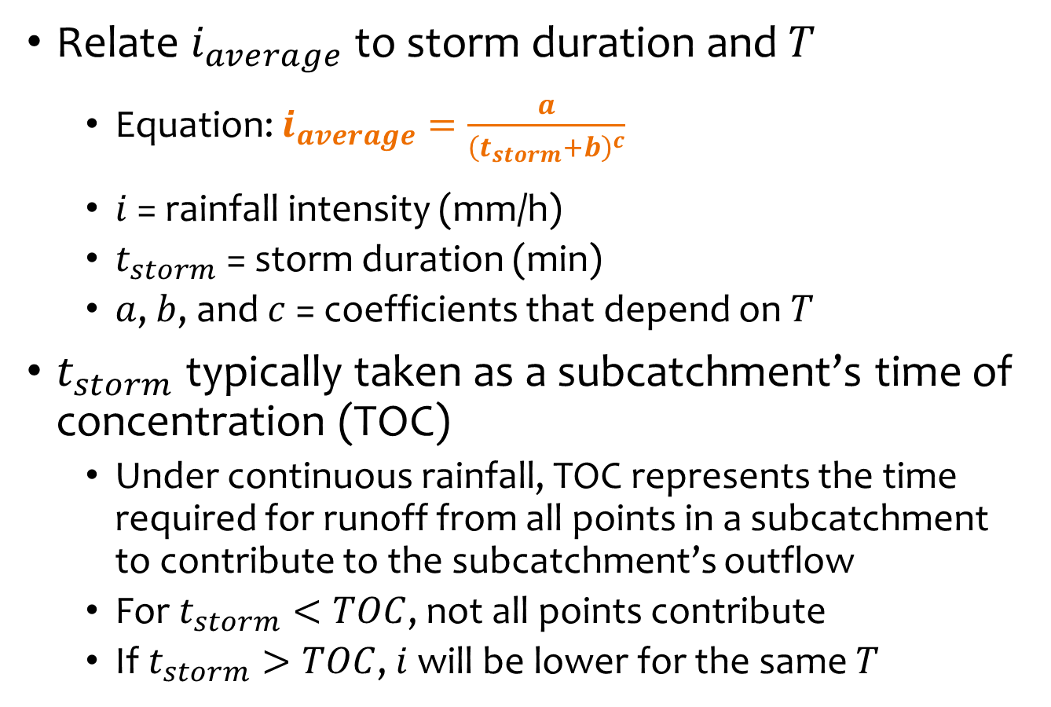
IDF Curves
Relate $i_{average}$ to storm duration and $T$
Equation: $i_{average}=\frac{a}{{\left(t_{storm}+b\right)}^{c}}$
$i$ = rainfall intensity (mm/h)
$t_{storm}$ = storm duration (min)
$a$, $b$, and $c$ = coefficients that depend on $T$
$t_{storm}$ typically taken as a subcatchment’s time of concentration (TOC)
Under continuous rainfall, TOC represents the time required for runoff from all points in a subcatchment to contribute to the subcatchment’s outflow
For $t_{storm}<TOC$, not all points contribute
If $t_{storm}>TOC$, $i$will be lower for the same $T$

Slide 14
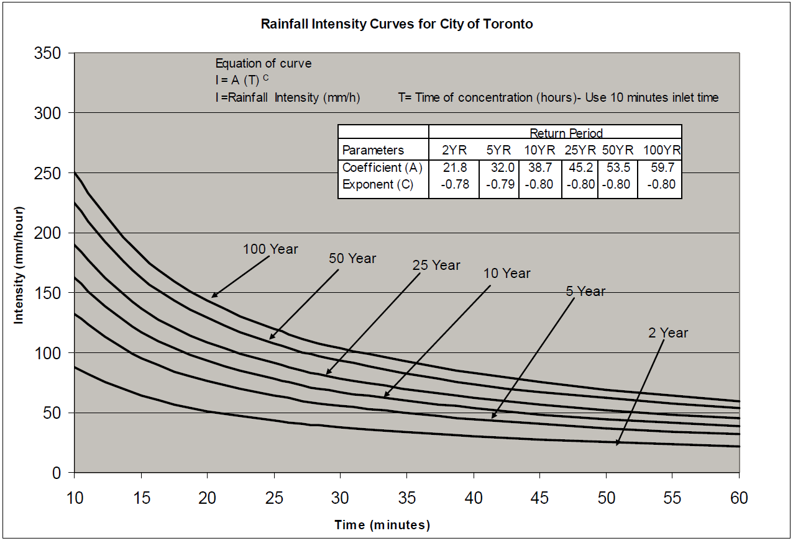
IDF Curves – City of Toronto
Wet Weather Flow Management Guidelines, City of Toronto (2006)

Slide 15
Infiltration Models
Many infiltration models have been developed:
Rational method: empirical, simple, based on constant runoff ratio
Horton method: empirical, considers variable infiltration rates based on initial and residual infiltration capacities
Green-Ampt Method: physically-based and semi-empirical, considers variable infiltration rates based on capacity, soil moisture, and hydraulic conductivity
NRCS curve number method: empirical, based on component analysis of infiltration processes considering storage (abstractions), infiltration, and runoff
…and many others
No model is best – each has its own applications

Slide 16
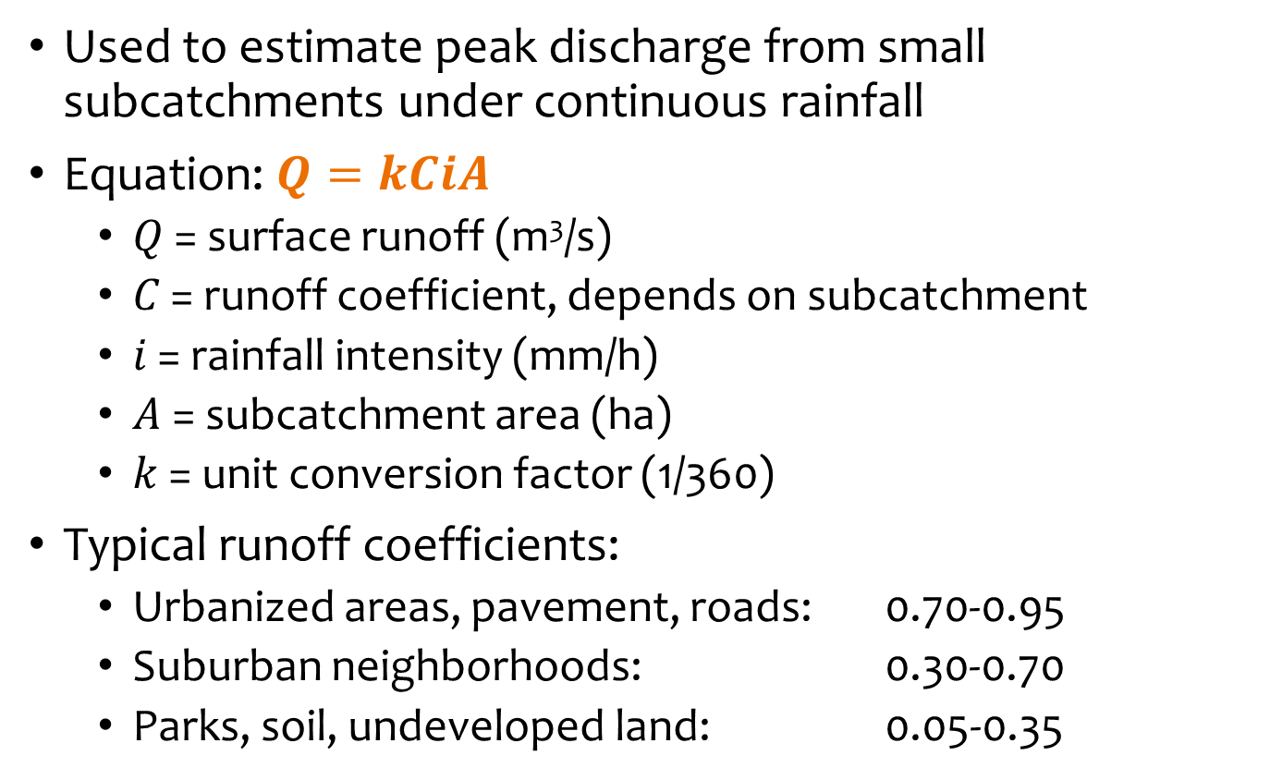
Rational Method
Used to estimate peak discharge from small subcatchments under continuous rainfall
Equation: $Q=kCiA$
$Q$ = surface runoff (m³/s)
$C$ = runoff coefficient, depends on subcatchment
$i$ = rainfall intensity (mm/h)
$A$ = subcatchment area (ha)
$k$ = unit conversion factor (1/360)
Typical runoff coefficients:
Urbanized areas, pavement, roads: 0.70-0.95
Suburban neighborhoods: 0.30-0.70
Parks, soil, undeveloped land: 0.05-0.35

Slide 17
Rational Method Assumptions
Time of concentration reached – all parts of subcatchment contributing to peak discharge
Runoff coefficient is constant and independent of soil conditions, rainfall intensity
Constant rainfall intensity
Uniformly distributed rainfall
Frequency of storm and runoff are the same

Slide 18
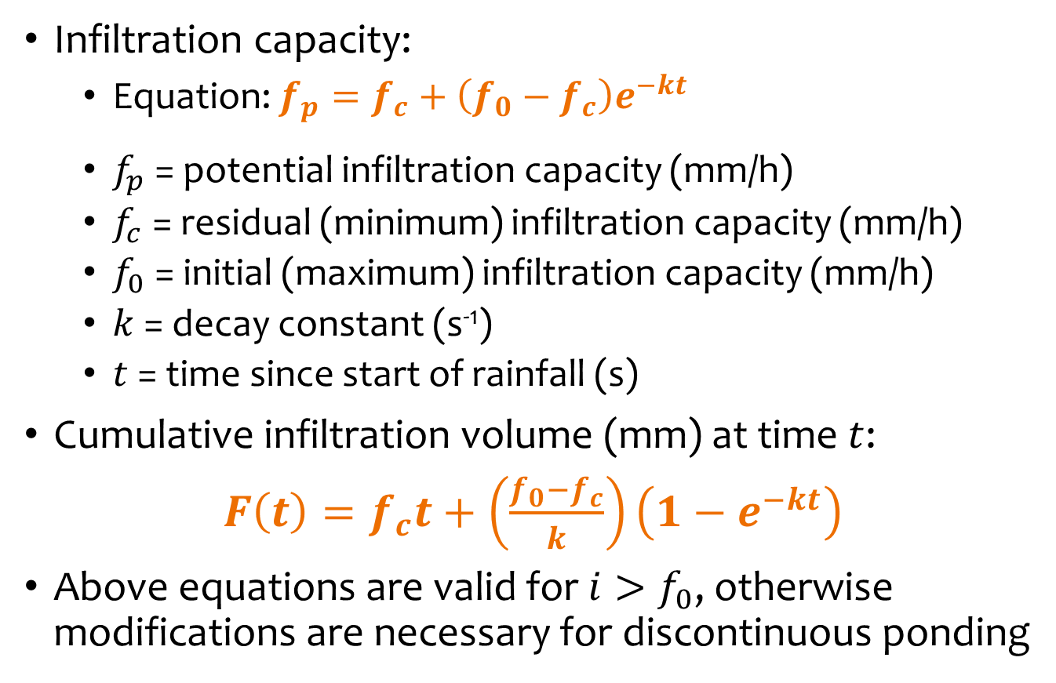
Horton Infiltration Model
Infiltration capacity:
Equation: $f_{p}=f_{c}+\left(f_{0}−f_{c}\right)e^{−kt}$
$f_{p}$ = potential infiltration capacity (mm/h)
$f_{c}$ = residual (minimum) infiltration capacity (mm/h)
$f_{0}$ = initial (maximum) infiltration capacity (mm/h)
$k$ = decay constant (s⁻¹)
$t$ = time since start of rainfall (s)
Cumulative infiltration volume (mm) at time $t$:
$F\left(t\right)=f_{c}t+\left(\frac{f_{0}−f_{c}}{k}\right)\left(1−e^{−kt}\right)$
Above equations are valid for $i>f_{0}$, otherwise modifications are necessary for discontinuous ponding

Slide 19
Horton Infiltration Model

Slide 20

Example – Horton Infiltration
Problem: Consider a soil with $f_{0}$ = 100 mm/h, $f_{c}$ = 20 mm/h, and $k$ = 20 h⁻¹. Given a constant rainfall intensity of $i$ = 120 mm/h, determine the runoff volume and average runoff rate after a period of 10 minutes. Assume no surface storage and immediate runoff.

Slide 21
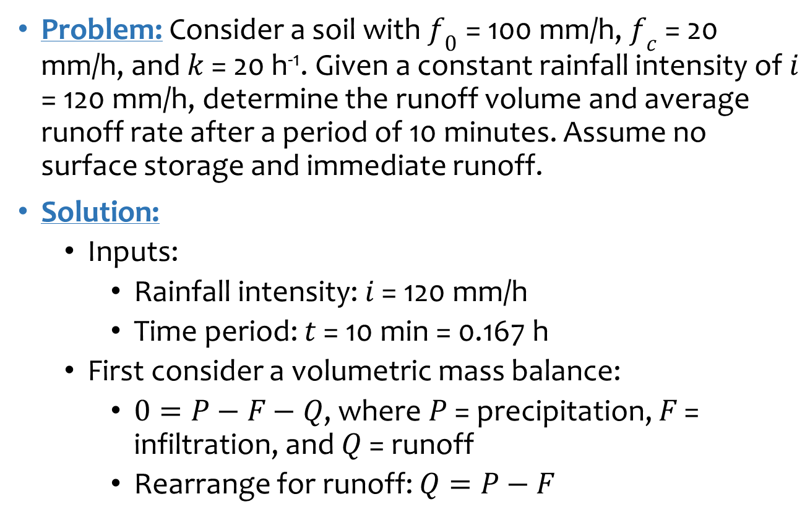
Example – Horton Infiltration
Problem: Consider a soil with $f_{0}$ = 100 mm/h, $f_{c}$ = 20 mm/h, and $k$ = 20 h⁻¹. Given a constant rainfall intensity of $i$ = 120 mm/h, determine the runoff volume and average runoff rate after a period of 10 minutes. Assume no surface storage and immediate runoff.
Solution:
Inputs:
Rainfall intensity: $i$ = 120 mm/h
Time period: $t$ = 10 min = 0.167 h
First consider a volumetric mass balance:
$0=P−F−Q$, where $P$ = precipitation, $F$ = infiltration, and $Q$ = runoff
Rearrange for runoff: $Q=P−F$

Slide 22
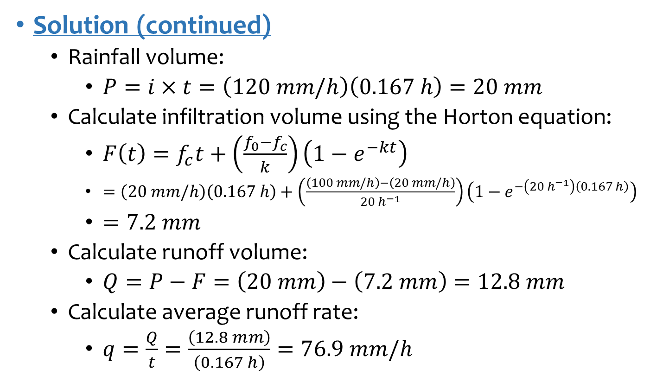
Example – Horton Infiltration
Solution (continued)
Rainfall volume:
$P=i×t=\left(120 mm/h\right)\left(0.167 h\right)=20 mm$
Calculate infiltration volume using the Horton equation:
$F\left(t\right)=f_{c}t+\left(\frac{f_{0}−f_{c}}{k}\right)\left(1−e^{−kt}\right)$
$=\left(20 mm/h\right)\left(0.167 h\right)+\left(\frac{\left(100 mm/h\right)−\left(20 mm/h\right)}{20 h^{−1}}\right)\left(1−e^{−\left(20 h^{−1}\right)\left(0.167 h\right)}\right)$
$=7.2 mm$
Calculate runoff volume:
$Q=P−F=\left(20 mm\right)−\left(7.2 mm\right)=12.8 mm$
Calculate average runoff rate:
$q=\frac{Q}{t}=\frac{\left(12.8 mm\right)}{\left(0.167 h\right)}=76.9 mm/h$

Slide 23

Fundamentals and Modeling
Review concepts provide basis for developing, using, and understanding water resources models
Models are a tool – useful for analysis, but not a substitute for reality
Knowledge of fundamentals is helpful for understanding when models are wrong

